Slide 1
Decision models

Slide 2
Decision model types
Decision tree
Markov model
Cohort-based state transition model (cSTM)
[Discrete time] Microsimulation
Individual-based state transition model (iSTM)
Others
Discrete event simulation (DES)
Compartmental models (e.g., SIR, SEIR, … )
Agent-based model (ABM)
Markov Decision Processes (MDP)
… etc

Slide 3
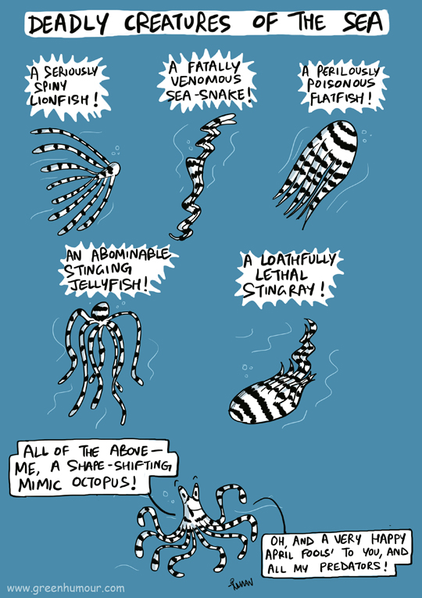
Model types
It is often challenging to decide what type of model to choose from a priori
Many modeling types can be modified to mimic other types
Decision trees → Markov
Markov → microsimulation
… etc
It is easier to use a suitable type to start with

Slide 4
Decision tree
Can do well | Can’t do very well
Multiple decisions | Repeating events
Multiple outcomes (cost, effectiveness, …etc) | Population heterogeneity
Multiple chained events | Irregular interval events (some short, some long)

Slide 5
Decision Tree
Define paths and outcomes
Paths are the chained probabilities for each decision to each terminal outcome
Example of payoffs are costs or utilities
Complex decision trees can be difficult to code: Tools to help: OpenTree and Amua
R code snippet:
expected_payoff = v_probs %*% v_payoffs

Slide 6
Decision Tree

Slide 7
Decision Tree
Path
Outcome

Slide 8
Markov models
Can do well | Can’t do very well
Multiple decisions | Population heterogeneity
Multiple outcomes (cost, effectiveness, …etc) | Irregular interval events (some short some long)
Multiple chained events
Repeating events

Slide 9
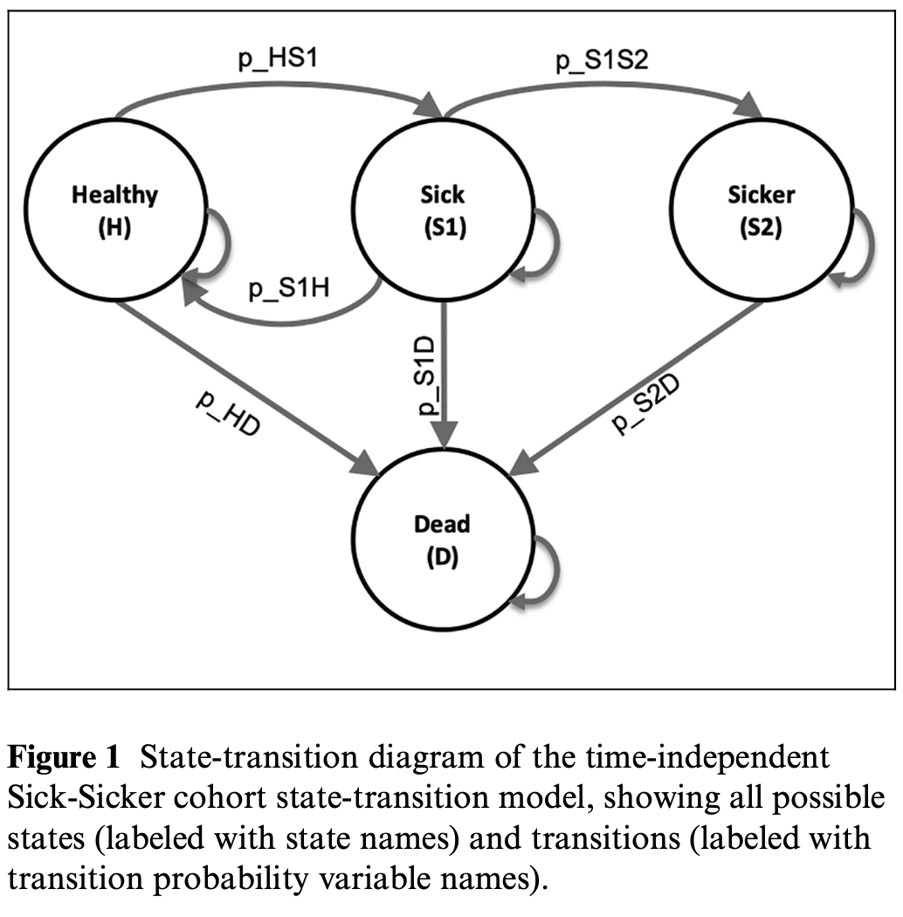
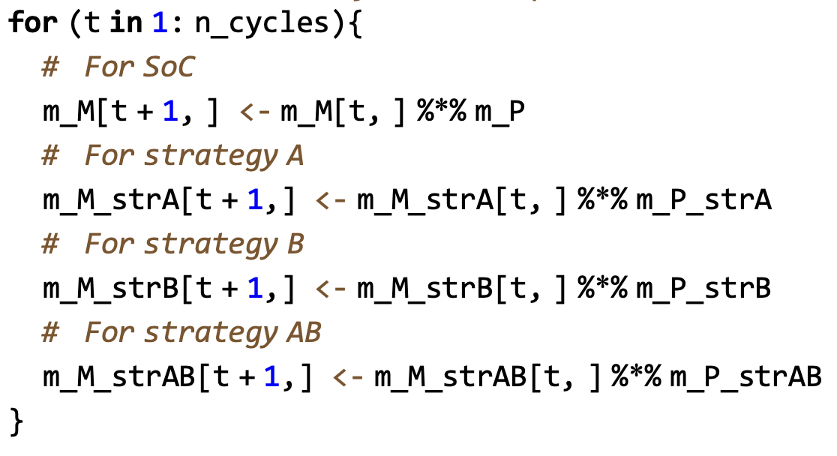
Markov Models

Slide 10
Markov Models
Define states, initial probabilities, and transition probabilities
Define rewards associated with states, cycles or events.
If probabilities are simulation time dependent (e.g., age-dependent) increase dimension of the transition probability matrix
If probabilities are state residency time dependent (e.g., time in a state), add tunnels of a state
If there are transition rewards (e.g., every time an event occurs, an additional procedure cost accrues or a disutility is applied), consider changing the dynamics of the Markov model using multi-dimensional array specification of the Markov trace

Slide 11
Microsimulation
Can do well | Can’t do very well
Multiple decisions | Irregular interval events (some short some long)
Multiple outcomes (cost, effectiveness, …etc)
Multiple chained events
Repeating events
Population heterogeneity

Slide 12
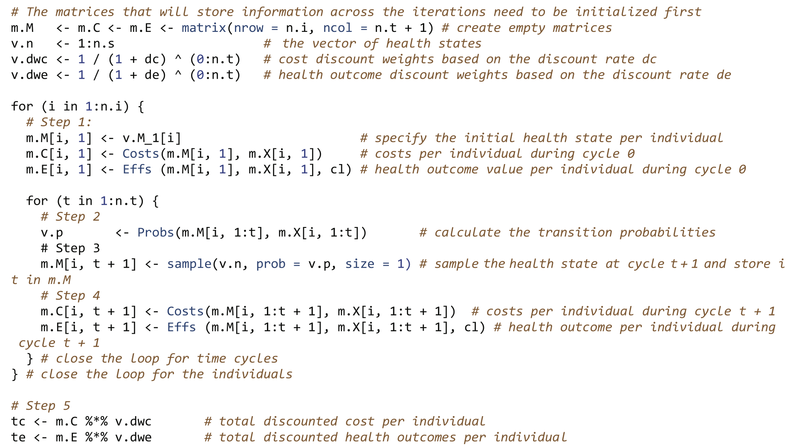
Microsimulation
Similar to Markov model, but here you can define simple equations that get applied to everyone.
A flat table structure works well where
Rows = individuals
Columns = cycles
each cycle the status of every individual is updated based on a set of equations
Example R code

Slide 13
Notice
If events occur at irregular intervals, a discrete event simulation may be a suitable model type.
Decision trees, Markov models, microsimulation and DES may not be well suited when there are interactions among people (e.g., infection transmission, behavioral influences … etc)
For these you can look into
Compartmental models e.g., SIR (Similar to Markov models but can involve interacting compartments)
Agent-based models, similar to a microsimulation or a DES but with the possibility of interactions among individuals.
If a decision recurs in every cycle (e.g., modeling time to making a decision) which requires nesting a decision node in each cycle, it may require a Markov Decision Process (MDP)

